Slide 1
Agenda- 1/11
Turn in syllabus/ current event sign-ups
Set up notebooks
Lecture1- Intro to Government (RS)
HW: Work on Test Review (RS)

Slide 2
Notebook Set-up
Take out your notebook and the papers I gave you on the first day.
Create a notebook cover page on the first page, with all your relevant information.
Place the “assignment log” right behind the notebook cover page.
Skip three pages.
Create your unit title page.
Put your first assignments after the unit title page (should be your crash course video worksheet and your test review).
Number your pages!

Slide 3
Unit 1 Lecture 1 Introduction to Government
What is government?
What are the different types of government?
What are the main concepts of democracy?

Slide 4
First, let’s define a couple of terms…
Government
The institution through which a society makes and enforces its public policies
Public Policies
All of those things a government decides to do

Slide 5
Why do we need a government?
The 6 purposes
To form a more perfect union
To establish justice
To ensure domestic tranquility
To provide for the common defense
To promote the general welfare
To secure the blessings of liberty

Slide 6
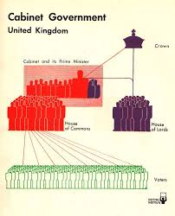
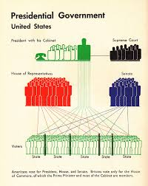
Not all governments are run in the same way. There are different ways to classify them…
1. The relationship between the branches of government (legislative-executive relationship)
Example: U.S. vs. England

Slide 7
2. Where the power lies
Unitary government- all powers belong to one single, central agency (Nazi Germany)
Federal government- powers are divided between a central government and several local governments (U.S.)
Confederate government- alliance of independent states (Civil War- confederacy)

Slide 8
3. Who Can Participate
Dictatorship- one ruler or group is not responsible to the will of the people (Nazi Germany)
Direct Democracy- The will of the people is directly translated into public policy (city government)
Representative Democracy (Republic)- A group of persons chosen by the people act to express the popular will (U.S.)

Slide 9
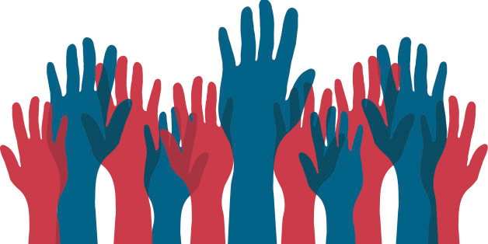
We are going to focus on the United States, a representative democracy with a federal system of government.
The 5 basic concepts of American democracy
Fundamental worth of the individual
Equality of all persons
Majority rule and minority rights
Necessity of compromise
Individual Freedom

